Slide 1
Fair use notice
The material used in this presentation i.e., pictures/graphs/text, etc. is solely intended for educational/teaching purpose, offered free of cost to the students for use under special circumstances of Online Education due to COVID-19 Lockdown situation and may include copyrighted material - the use of which may not have been specifically authorized by Copyright Owners. It’s application constitutes Fair Use of any such copyrighted material as provided in globally accepted law of many countries. The contents of presentations are intended only for the attendees of the class being conducted by the presenter.

Slide 2
OBJECT ORIENTED PROGRAMMING
Presented by: Engr. Mariam Memon

Slide 3

Table of contents
Multithreading
Synchronization

Slide 4
Multi-threading
Java is a multi-threaded programming language which means we can develop multi-threaded program using Java.
A thread is actually a lightweight process.
Unlike many other computer languages, Java provides built-in support for multithreaded programming.
A multithreaded program contains two or more parts that can run concurrently.
Each part of such a program is called thread and each thread defines a separate path of execution.
Thus, multithreading is a specialized form of multitasking.
Multi-threading enables you to write in a way where multiple activities can proceed concurrently in the same program.

Slide 5
Thread
A thread is a lightweight subprocess
The smallest unit of processing
It is a separate path of execution.
Threads are independent.  If there occurs exception in one thread, it doesn't affect other threads.
Every java application has at least one thread – main thread.
And we can create multiple threads from it

Slide 6
Advantages of Using Threads
It doesn't block the user because threads are independent and you can perform multiple operations at the same time.
You can perform many operations together, so it saves time.
Threads are independent, so it doesn't affect other threads if an exception occurs in a single thread

Slide 7
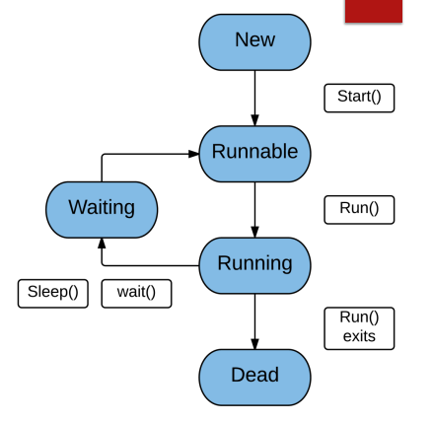
Thread Life-Cycle
In java, there are several stages which a thread undergoes in its lifecycle and is managed by the Thread Scheduler, a part of Java Virtual Machine(JVM).

Slide 8
Contd.
New- When an instance of thread class is created, the thread is said to be born and begins its life in the New state. It stays in this state until the start() method is invoked to perform further operations.
Runnable- The thread is said to be in Runnable state when the start() method has been invoked but it has not been selected to be in the running state by the thread scheduler.
Running- After the thread has been selected by the thread scheduler, it is said to be in the Running state.
Waiting- In this state, a thread waits for another thread to perform a particular task. When the task is finished, then another thread responds back to the waiting thread to continue performing its task. In other words, the waiting thread comes back to the running state.
Terminated/ Dead-When a running thread has finished its task, it reaches the terminated state or dead state.

Slide 9
Creating a Thread
Java provides two ways to create a thread programmatically.
Implementing the java.lang.Runnable interface.
Extending the java.lang.Thread class.

Slide 10
Implementing a Runnable Interface
If your class is intended to be executed as a thread then you can achieve this by implementing a Runnable interface. You will need to follow three basic steps
Step 1: To implement Runnable interface, a class need only implement a single method called run( ), which is declared like this:
public void run()
Step 2: As a second step, you will instantiate a Thread object using the following constructor −
Thread(Runnable threadObj, String threadName);
Where, threadObj is an instance of a class that implements the Runnable interface and threadName is the name given to the new thread.
Step 3: Once a Thread object is created, you can start it by calling start() method, which executes a call to run( ) method.
Following is a simple syntax of start() method
void start();

Slide 11
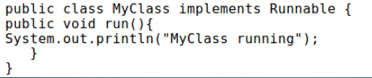

Example
In the main Method

Slide 12


Extending the Thread Class
The second way to create a thread is to create a new class that extends Thread, then override the run() method and then to create an instance of that class. The run() method is what is executed by the thread after you call start().
In the main Method

Slide 13
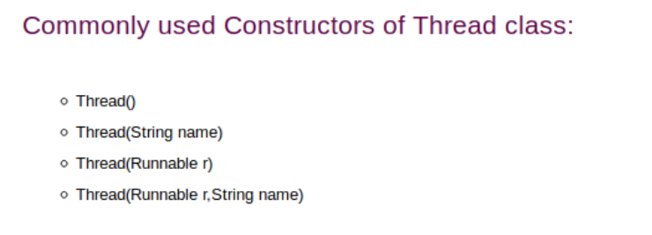

Slide 14
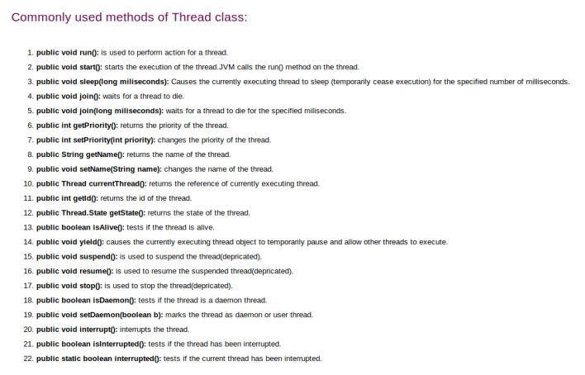

Slide 15
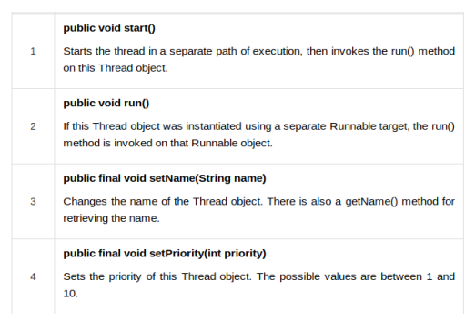
Some Important Thread Methods

Slide 16
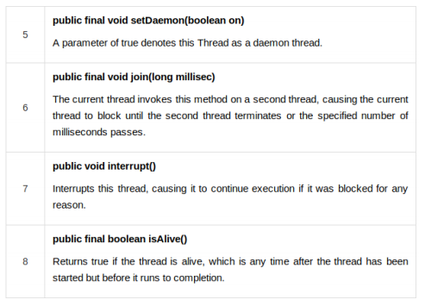
Contd.

Slide 17
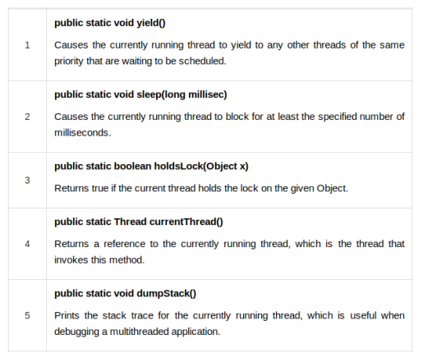
Some Important Static Thread Methods

Slide 18
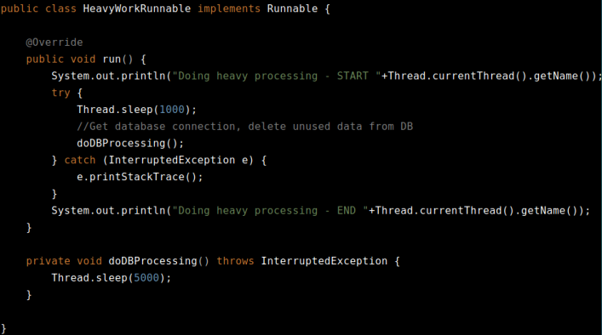
Example

Slide 19
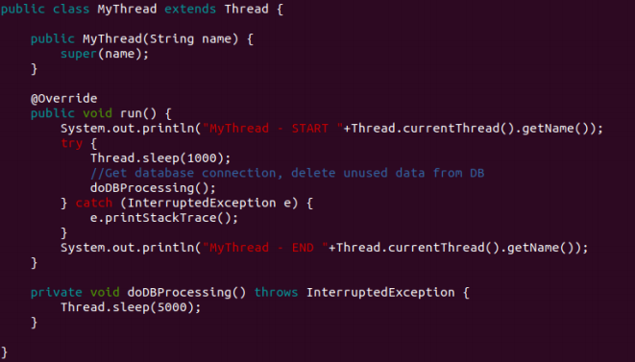

Slide 20
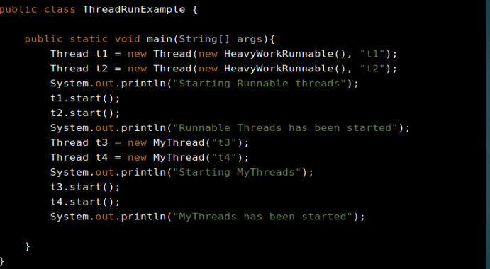

Slide 21
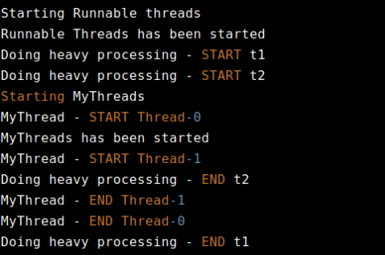
Output

Slide 22
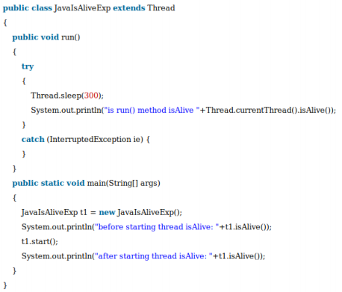
isAlive() Example

Slide 23

Output

Slide 24
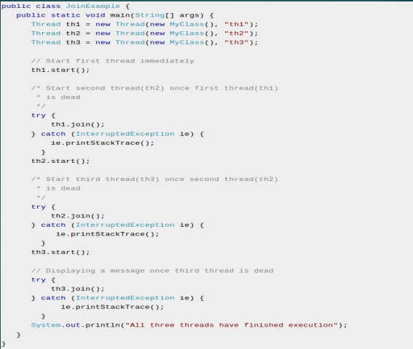
join() Example

Slide 25
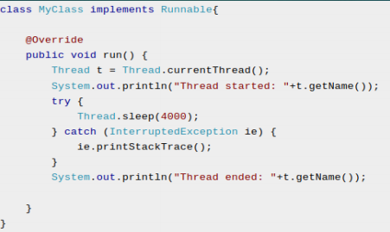
Contd.

Slide 26
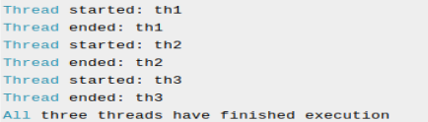
Output

Slide 27
setPriority()
The setPriority() method of thread class is used to change the thread's priority.
Every thread has a priority which is represented by the integer number between 1 to 10.
Thread class provides 3 constant properties:
public static int MIN_PRIORITY: It is the maximum priority of a thread. The value of it is 1.
public static int NORM_PRIORITY: It is the normal priority of a thread.
The value of it is 5.
public static int MAX_PRIORITY: It is the minimum priority of a thread. The value of it is 10.

Slide 28
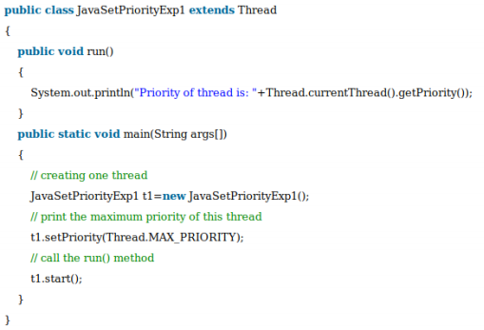
Example

Slide 29

Output

Slide 30
Synchronization
At times when more than one thread try to access a shared resource, we need to ensure that resource will be used by only one thread at a time.
The process by which this is achieved is called synchronization.
This is implemented using a concept called monitors.
Each object in Java is associated with a monitor, which a thread can lock or unlock.
Only one thread at a time may hold a lock on a monitor.

Slide 31
Why Synchronize?
If we do not use syncronization, and let two or more threads access a shared resource at the same time, it will lead to distorted results.
Consider an example, Suppose we have two different threads T1 and T2
T1 starts execution and save certain values in a file temporary.txt which will be used to calculate some result when T1 returns.
Meanwhile, T2 starts and before T1 returns, T2 change the values saved by T1 in the file temporary.txt (temporary.txt is the shared resource).
Now obviously T1 will return wrong result.
To prevent such problems, synchronization was introduced. With synchronization in above case, once T1 starts using temporary.txt file, this file will be locked(LOCK mode), and no other thread will be able to access or modify it until T1 returns

Slide 32
Two Ways
By using synchronized methods
Use synchronized keyword with methods allows you to restrict access of that method for a particular object to only one thread at a time
Syntax:
modifier synchronized return-type method-name(parameters)
By using synchronized blocks
If you have to synchronize access to an object of a class or you only want a part of a method to be synchronized to an object then you can use synchronized block for it.
Syntax:
synchronized(objectIdentifier) {
//code to synchronize
}

Slide 33
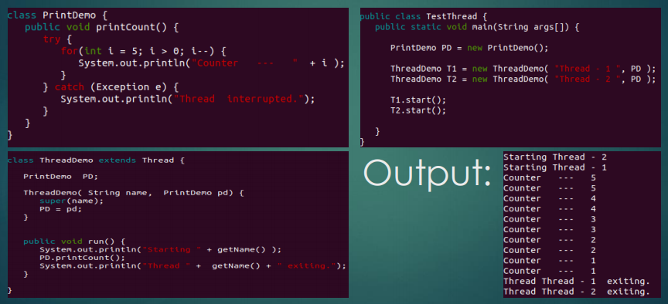
Example without Synchronization

Slide 34
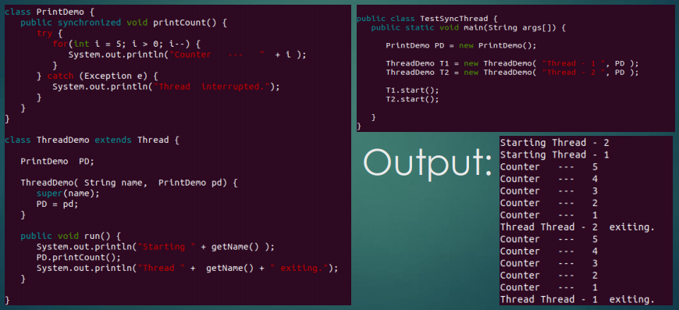
Example with Synchronized Method

Slide 35
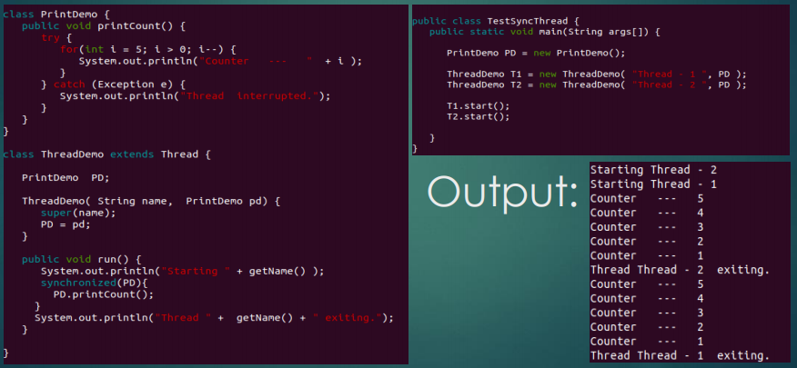
Example with Synchronized Block

Slide 36
Synchronized Method vs Synchronized Block
When we use synchronized keyword with a method, it acquires a lock in the object for the whole method.
It means that no other thread can use any synchronized method until the current thread, which has invoked it's synchronized method, has finished its execution.
synchronized block acquires a lock in the object only between parentheses after the synchronized keyword.
This means that no other thread can acquire a lock on the locked object until the synchronized block exits. But other threads can access the rest of the code of the method.

Slide 37
THANK YOU!

